Slide 1
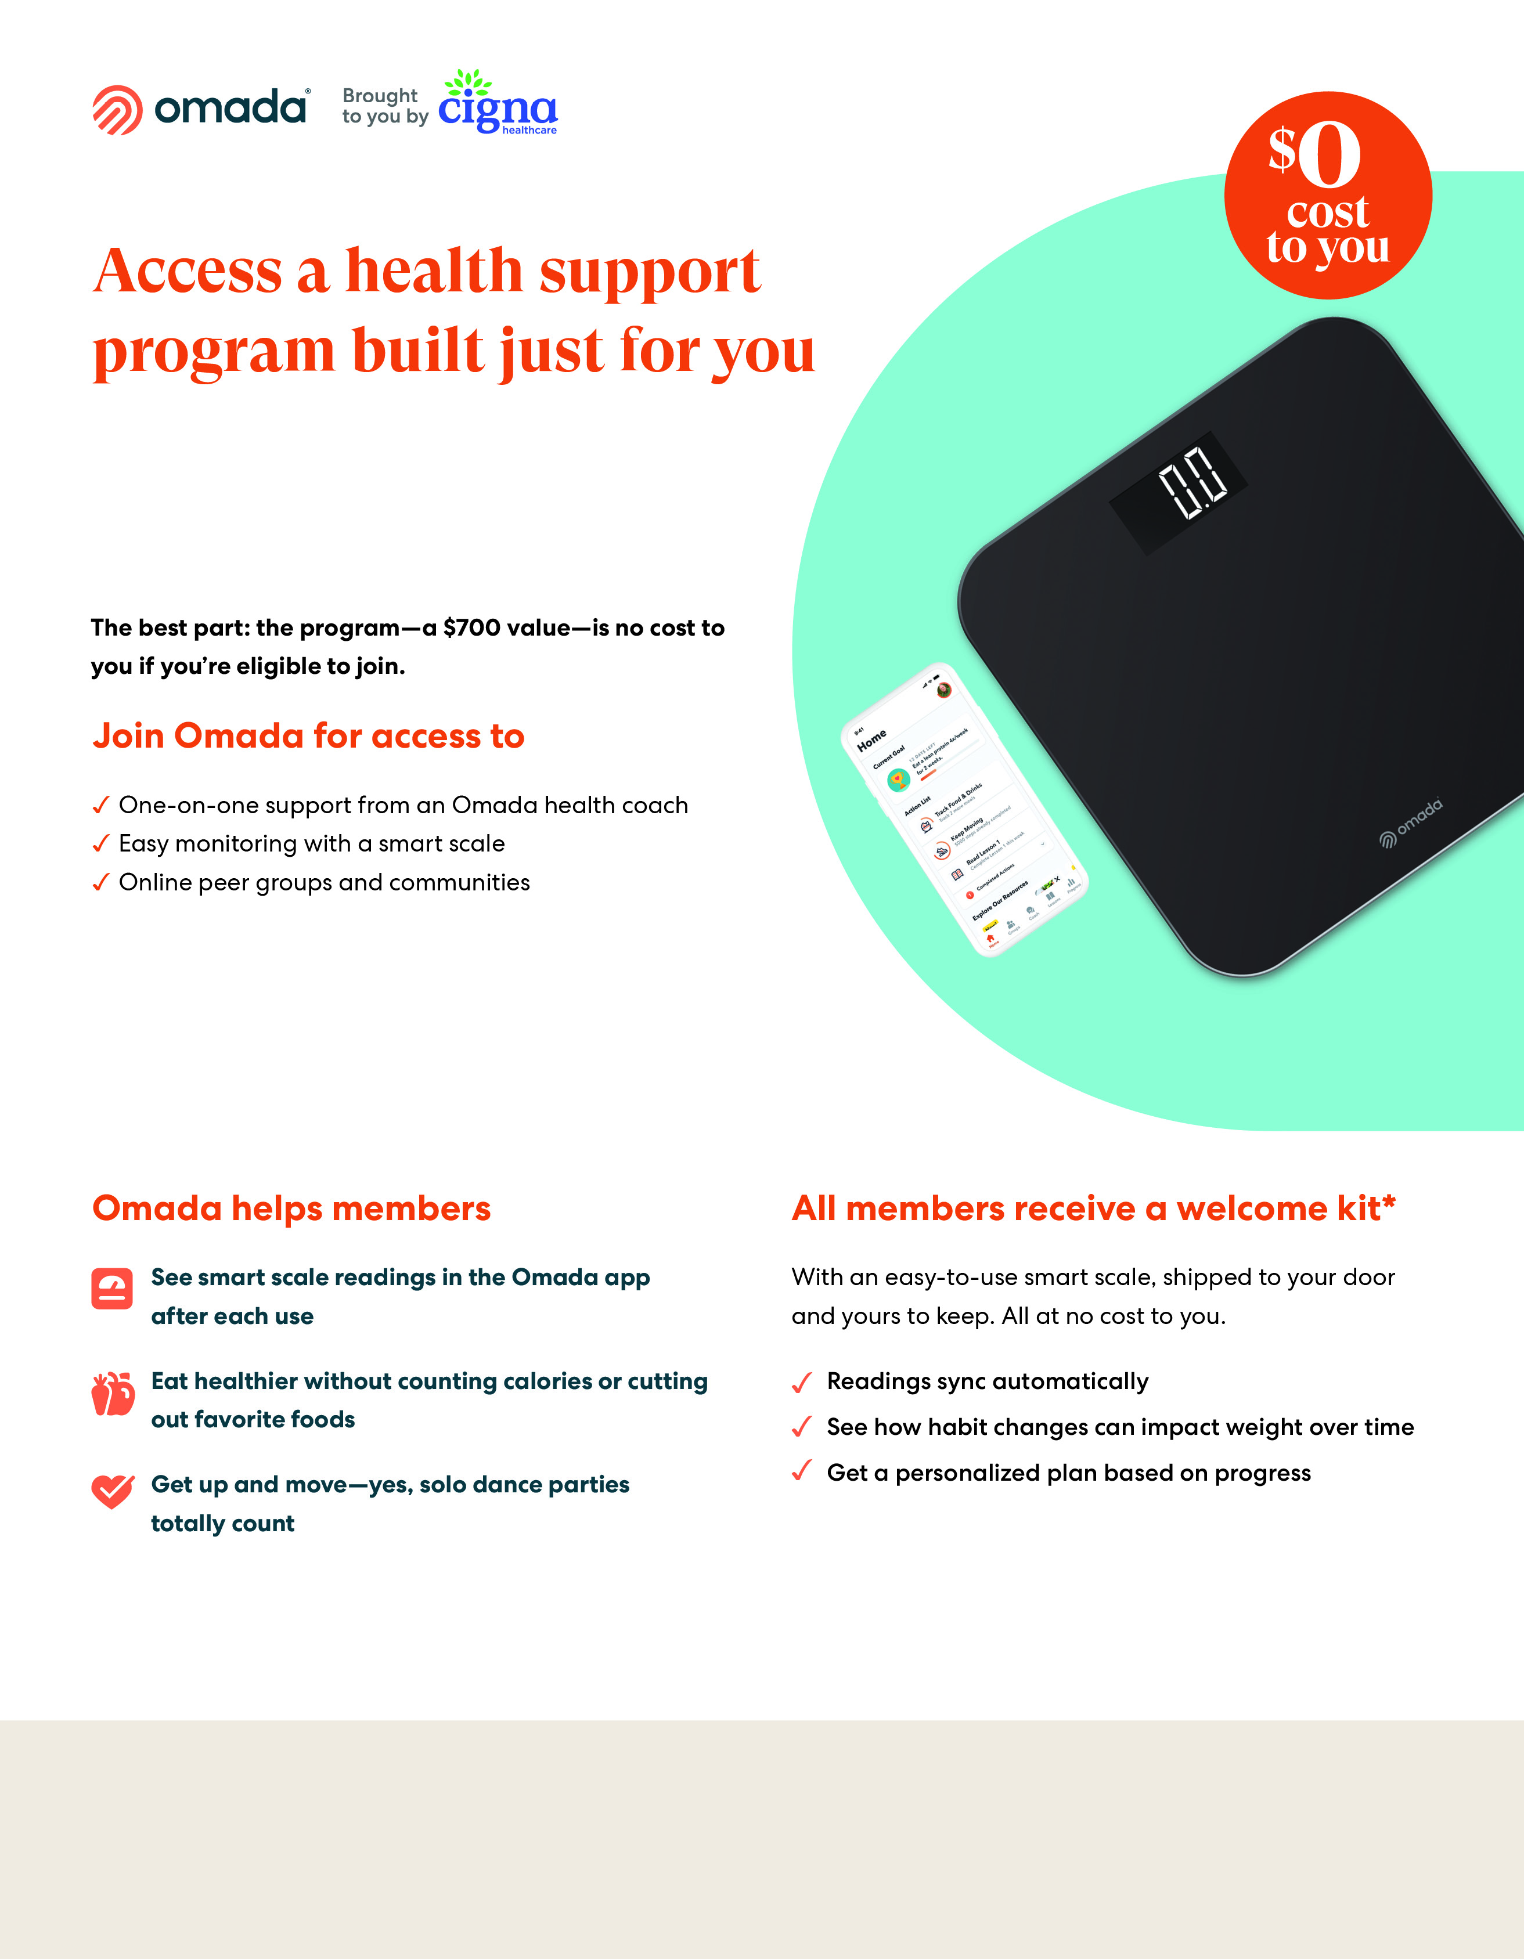

Cigna is offering Omada® to help members manage weight and create healthier habits with one-on-one personal coaching and the tools needed to make long- lasting health changes.
Claim My Benefit
omadahealth.com/omadaforcigna
If you or your covered adult dependents are enrolled in the company medical plan offered through Cigna, are at risk for type 2 diabetes or heart disease, and are accepted into the program, you’ll receive the program at no additional cost.
*Certain features and smart devices are only available if you meet program and clinical eligibility requirements.
Images, including apps, do not reflect real members or information about a specific person
The Omada® program is administered by Omada Health, Inc., an independent third party service provider. All Cigna® products and services are provided exclusively by or through operating subsidiaries of Cigna Corporation, including Cigna Health and Life Insurance Company or its affiliates. The Omada® program is not administered by Cigna. It is administered solely by Omada Health, Inc. which is responsible for the program..

